Slide 1
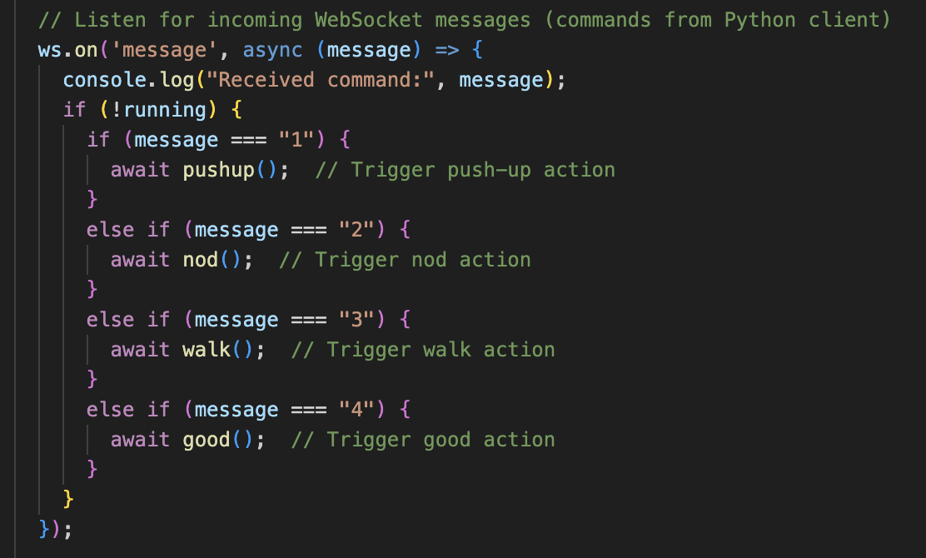
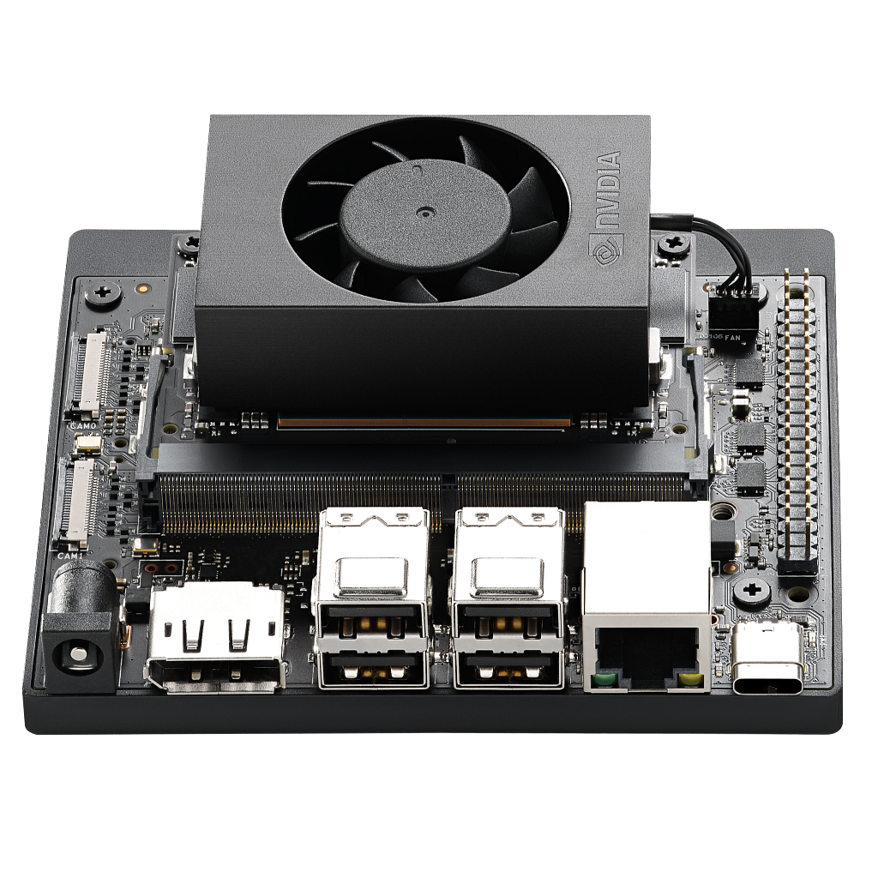
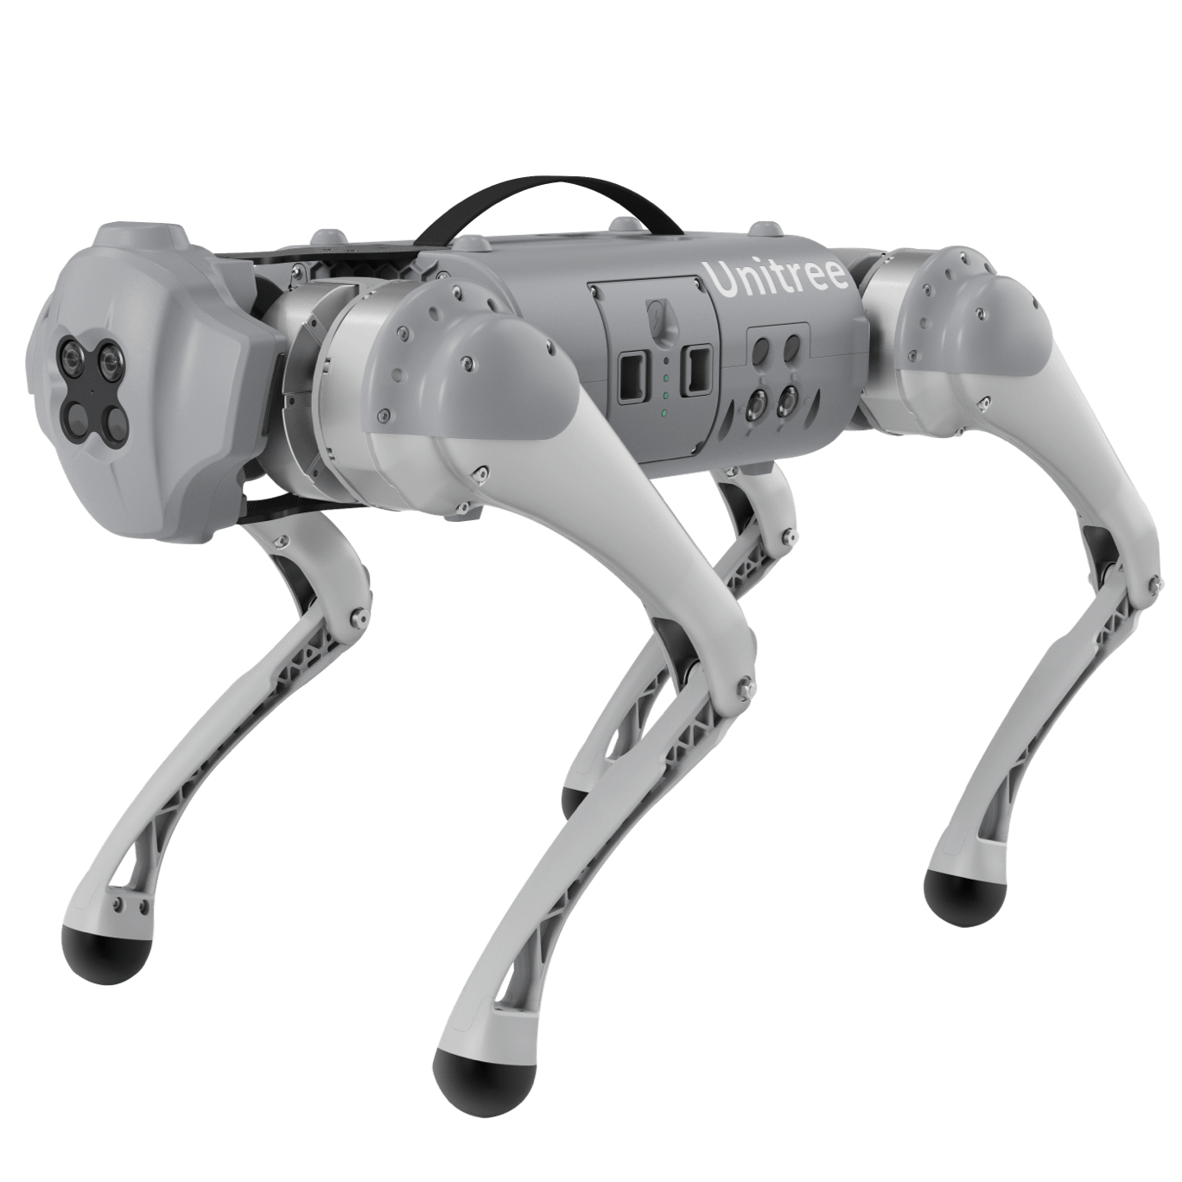
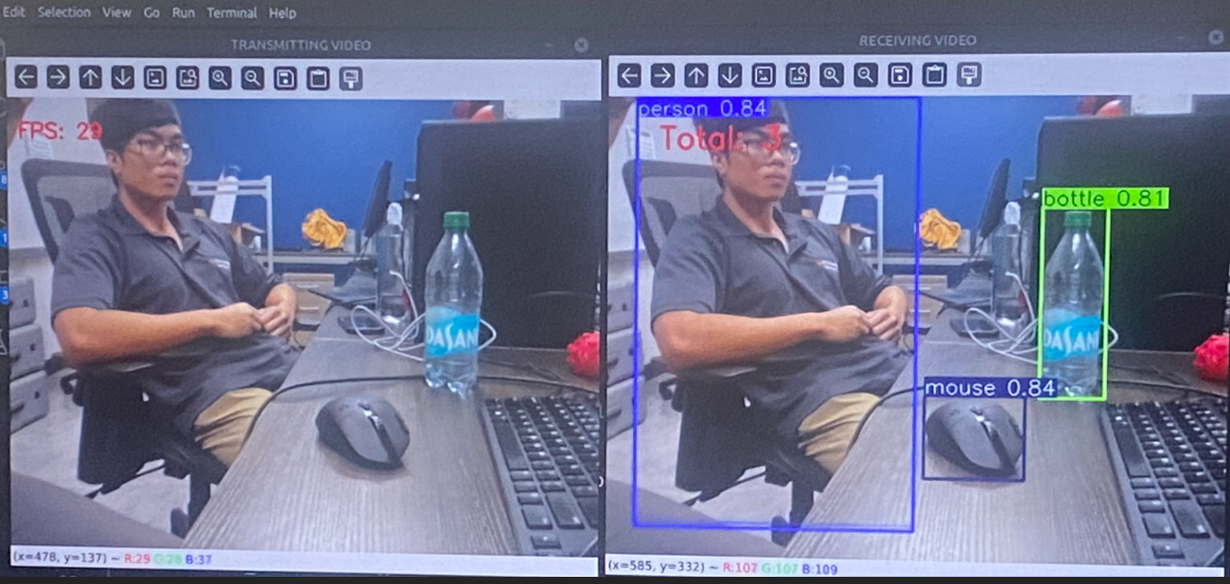
Intelligent and Collaborative Autonomous Robots for Real-Time Applications
Team Members
Faculty Advisor & Staff
Ian Simmons
David Uzan
John Sinfuego
Dr. Hari Kalva, Ashan Perera, and Jefferson Charles
Department of Electrical Engineering & Computer Science
#10
Problem Statement
Creating software that can allow a robot to move by itself given a live feed is an ever-growing necessity as automation becomes more widespread. Our mission with this project is to create an autonomous Unitree Go-1 robot, that would perform a variety of actions based on the objects it is able to detect. With further development, the robot will be able to carry out applications in supplementary services and field uses where conditions may be too hazardous for humans.
Results
Using the more capable processing power of the NVIDIA Jetson Nano Orin, an object tracking model named YOLO from Ultralytics has been incorporated. Using the provided model, the robot will detect an object, if it is one of interest it will execute a predetermined action autonomously. Some examples include directional movement, sending location, object identification, and timestamping.
Conclusions & Impact
This project highlights the potential of real-time object detection in autonomous robots for industries requiring precise, independent operations. By incorporating YOLOv11, the Uni-Go1 robot, is capable of dynamic object detection and response, enabling applications in monitoring, inspections, and task automation across diverse environments. This contributes to the field of robotics by demonstrating effective AI integration on constrained hardware. In conclusion, Intelligent and Collaborative Autonomous Robots for Real-Time-Applications advances real-time detection capabilities in autonomous systems.

Slide 2
Intelligent and Collaborative Autonomous Robots for Real-Time Applications
Team Members
Faculty Advisor & Staff
Ian Simmons
David Uzan
John Sinfuego
Dr. Hari Kalva, Ashan Perera, and Jefferson Charles
Department of Electrical Engineering & Computer Science
#10
Problem Statement
Creating software that can allow a robot to move by itself given a live feed is an ever-growing necessity as automation becomes more widespread. Our mission with this project is to create an autonomous Unitree Go-1 robot, that would perform a variety of actions based on the objects it is able to detect. With further development, the robot will be able to carry out applications in supplementary services and field uses where conditions may be too hazardous for humans.
Results
Using the more capable processing power of the NVIDIA Jetson Nano Orin, an object tracking model named YOLO from Ultralytics has been incorporated. Using the provided model, the robot will detect an object, if it is one of interest it will execute a predetermined action autonomously. Some examples include directional movement, sending location, object identification, and timestamping.
Conclusions & Impact
This project highlights the potential of real-time object detection in autonomous robots for industries requiring precise, independent operations. By incorporating YOLOv11, the Uni-Go1 robot, is capable of dynamic object detection and response, enabling applications in monitoring, inspections, and task automation across diverse environments. This contributes to the field of robotics by demonstrating effective AI integration on constrained hardware. In conclusion, Intelligent and Collaborative Autonomous Robots for Real-Time-Applications advances real-time detection capabilities in autonomous systems.

